Slide 1
YELP-DATASET CHALLENGE

Slide 2
ROLES:
Aishwarya Dhage | Information Gathering for Task 1 | Implementation of Collaborative Filtering approach | Improvement and refining the code for Task 1
Praneta Paithankar | Database generation using Json and MongoDB for Task 1 | Implementation of Information Retrieval approach | Improvement and refining the code for Task 1
Nawaz Hussain K | Extraction of tokenized reviews words(NN and NNS) from mongoDB. | Generated probability distribution of frequently addressed categories. Plotted heatmap of proposed businesses on the map of city Charlotte. | Accuracy Evaluation of the results obtained from the program.

Slide 3
TASK 1:REFINING DATASET
In this task, we are considering data for Charlotte.
We used mongodb database.
We are considering only restaurants for this task.
We are considering businesses whose total reviews are equal and greater than 100 and users who have given at least 20 reviews.
We divided data into two sets on the basis of review date.
All reviews before 1-1-2015 are considered as training data and remaining reviews are considered as testing data.

Slide 4
TASK 1:INFORMATION RETRIEVAL
Proposed Algorithm-
1.We are using information retrieval to recommend businesses to users based on their reviews.
2.To improve our dataset of reviews we have extracted nouns and adjectives from each review using opennlp.
3.We have used user’s reviews to understand his preferences of restaurants.
4. We have used Lucene to retrieve information from training data.

Slide 5
TASK 1:INFORMATION RETRIEVAL
Experiment Design-
1.For generating index we have created a new document for each restaurant.
2.We have extracted nouns and adjectives from each review and added those tokens in the document.
3.We have used all reviews of each user as a query to find recommendations.
4.To get the top recommendation for each user, we have used standard analyser and bm25 similarity.

Slide 6
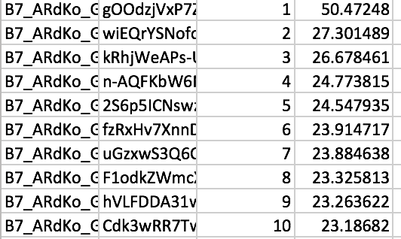
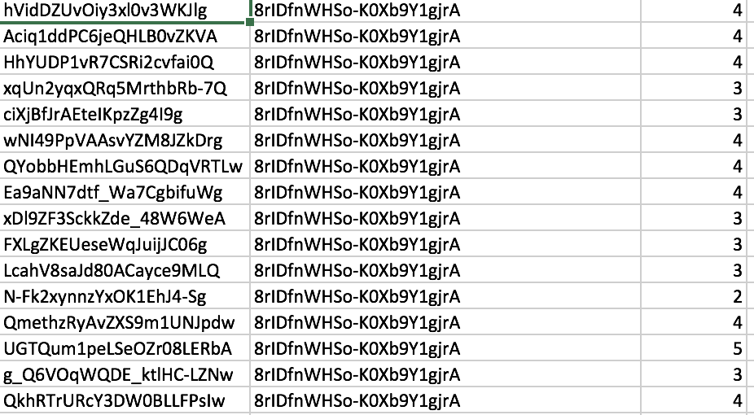
Task 1:Information Retrieval Approach
Output File of Recommendations-
Ground Truth-

Slide 7
TASK 1:COLLABORATIVE FILTERING APPROACH
Proposed Algorithm-
We are using Collaborative Filtering to suggest businesses to user.
For a user:
We can suggest businesses using item-based collaborative filtering.
As we already have (preference) data of the existing user, calculating similarities of ranked businesses and predicting the rank of unranked businesses will not be a problem.
User will be suggested new business depending on their rating(or preferences) of other businesses.

Slide 8
TASK 1:COLLABORATIVE FILTERING APPROACH
Experiment Design-
In this approach we have used Item-Item based collaborative filtering using Mahout.
1.We will generate a model based on the user ratings given to a business.
2.We have used this model to find similarity between items.
3.To calculate similarity, we have used PearsonCorrelationSimilarity.
4.Using recommender builder we have generated all the recommendations for a user.We have provided top 50 recommendations for each user.

Slide 9
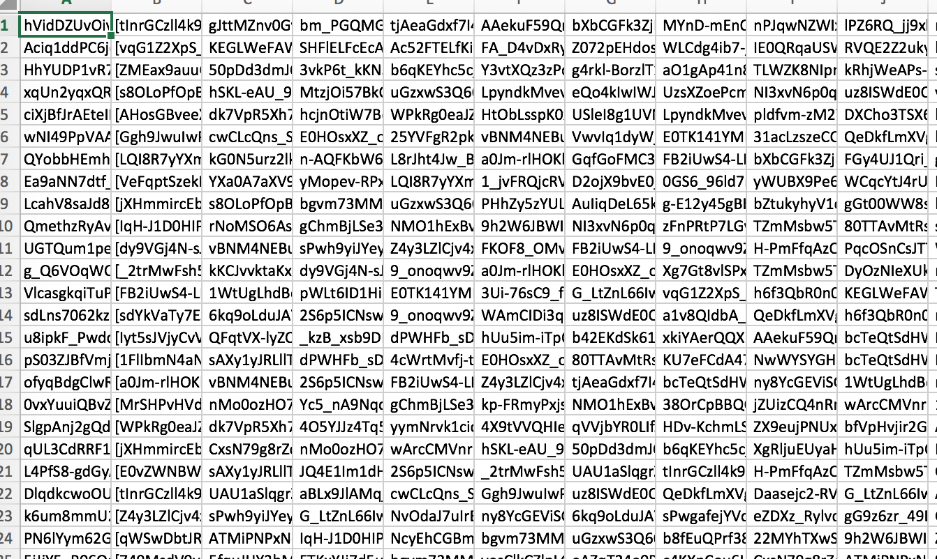
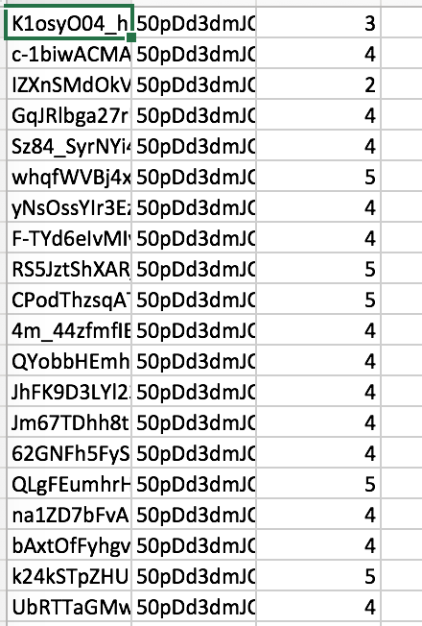
TASK 1:COLLABORATIVE FILTERING APPROACH
Output File of Recommendations-
Ground Truth-

Slide 10
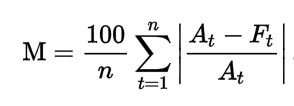
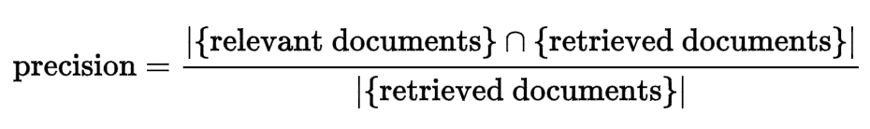
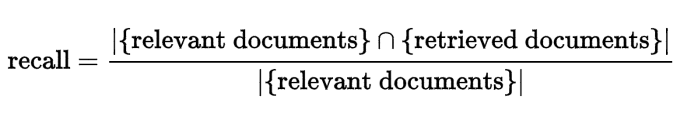
TASK 1: EVALUATION METRICS
We have used
1.Mean Absolute Percentage error.
2.Precision
3.Recall

Slide 11
TASK 1:
Comparison of Collaborative Filtering and Information Retrieval.
 | Collaborative Filtering | Information Retrieval
Recall-Top 25 | 0.08 | 0.09
Precision-Top 25 | 0.04 | 0.05
Recall-Top 50 | 0.15 | 0.17
Precision-Top 50 | 0.04 | 0.04
Recall-Top 100 | 0.31 | 0.30
Precision-Top 100 | 0.04 | 0.04

Slide 12
TASK 1:
Comparison of Collaborative Filtering and Information Retrieval.
No. Of Recommendations | Collaborative Filtering(MAPE) | Information Retrieval(MAPE)
25 | 92.45 | 91.61
50 | 85.06 | 84.41
100 | 69.45 | 72.65

Slide 13
TASK 1:CONCLUSION AND FUTURE WORK
We have observed that from top recommended business to user visits 20% of the businesses.
For future work we feel that,extracting sentiments of users through reviews and tips and giving weightage to each review accordingly will improve accuracy.In case of collaborative filtering we can normalize rating using this weightage calculation.

Slide 14
Task 2: Recommend location to user to open a specific cuisine of restaurant
Approach:
All the businesses belonging to the city = “Charlotte” were uploaded in the database. All the reviews addressing the businesses in the city charlotte were uploaded in the DB.
Reviews were tokenized, and nouns and plural nouns were extracted as bag of words for each review and stored in another separate collection.
Natural Language Toolkit was used for the lexical analysis and parts of speech tagging of the reviews.
Corpora package of Genism Library is used to retain frequently occurring words from the review.
Generated the probability distribution of the bag of all the filtered words using Latent Dirichlet Allocation ( gensim.models.LdaModel)
Top Sixty topics with their probability distribution are collected. These are the keywords(frequent words in the review) which will be proposed to the user.
All the words are stored in dictionary with their corresponding id value and probability value.

Slide 15
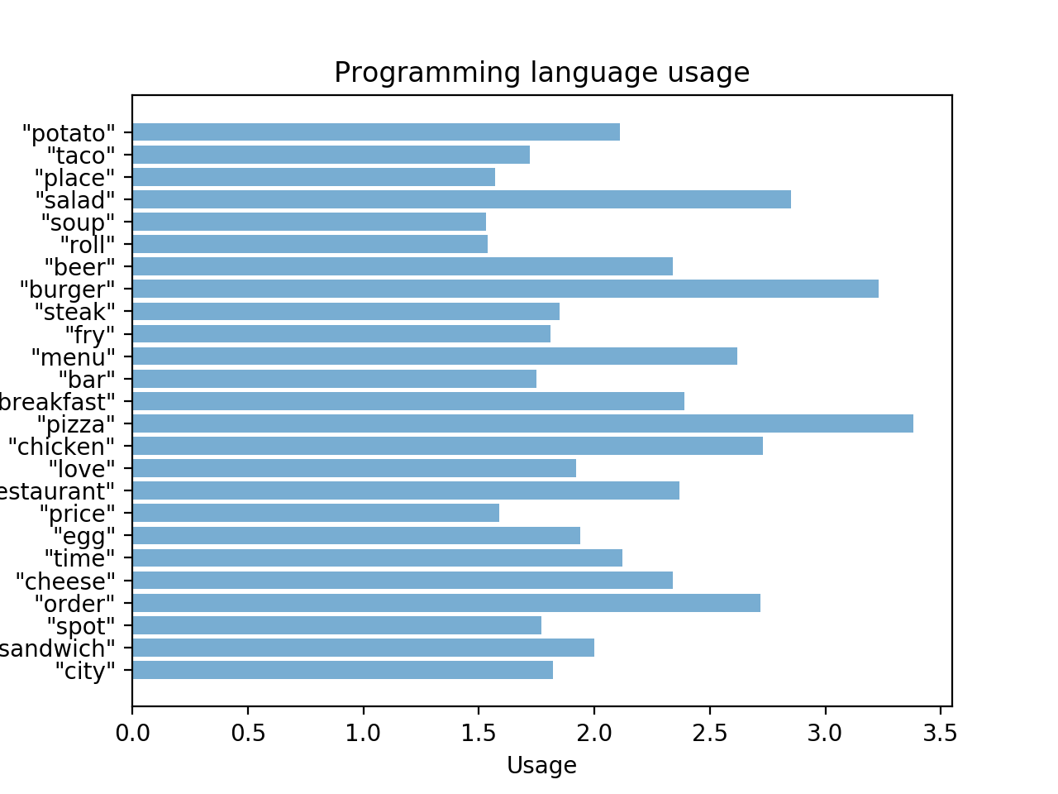
Task 2: Recommend location to user to open a specific cuisine of restaurant

Slide 16
Task 2: Recommend location to user to open a specific cuisine of restaurant
Approach:
For each tokenized word from the review, we calculate its weight of it using the rating of the restaurant.
Frequency count for each word is also calculated. For each business, the words (NN and NNS) are weighted as per the ratings given to each business.
HeatMap is plotted for a sample Cuizine (say Sandwich and Salad) with a sample rating (say 2). This heatmap represents the places in Charlotte which serve Cuisines ( Sandwich and Salad) and have a rating more than the given sample rating.
This HeatMap can be used by the user to judge the places which serve most popular (sample) cuisines. The user can now chose a place strategically, if they want to setup their own business with the sample cuisine or not.

Slide 17
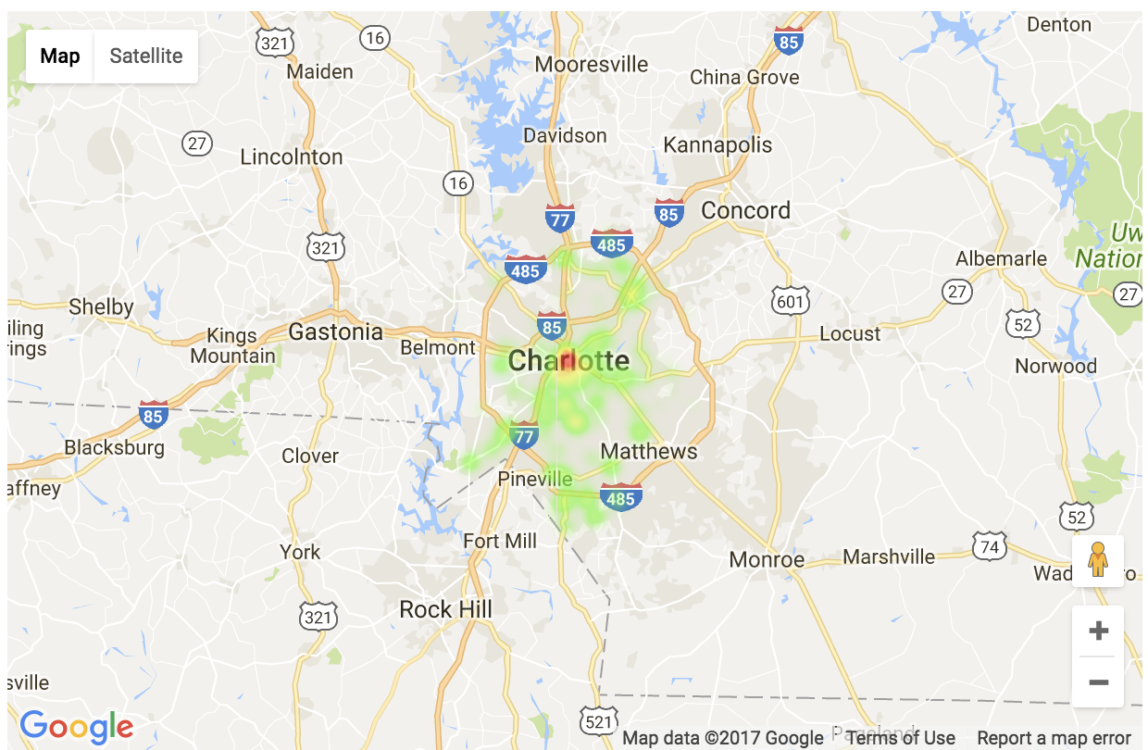
Task 2: Recommend location to user to open a specific cuisine of restaurant
HeatMap of City Charlotte representing the places serving Sandwiches having Rating more than 2.

Slide 18
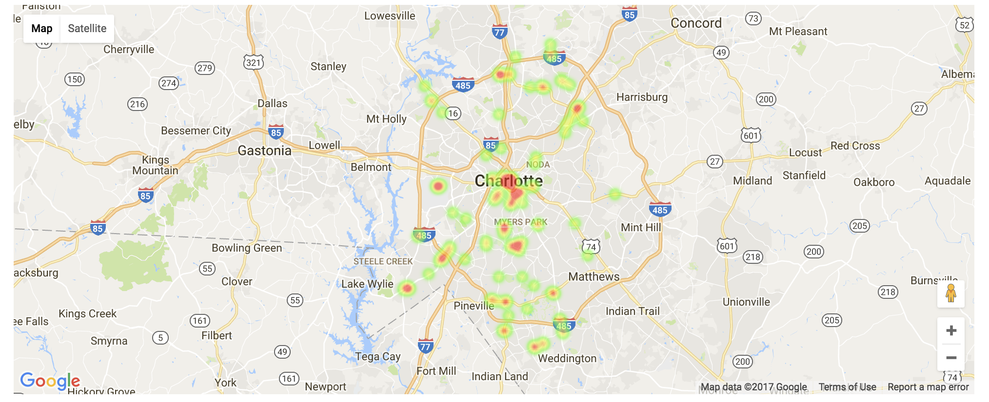
Task 2: Recommend location to user to open a specific cuisine of restaurant
HeatMap of City Charlotte serving cuisine Salad with rating more than 2

Slide 19
Task 2: Recommend location to user to open a specific cuisine of restaurant
Evaluation:
To Evaluate the accuracy of the HeatMap predicted by the program, we search for the restaurant which is actually serving (sample) category with an rating equal or higher than the one specified by the user initially.
We select all those category-ied businesses and plot their heat map.
We also Calculate a Hit-Ratio for every successful identification of the business retrieved from the review and one from the category (attribute of the dataset).

Slide 20
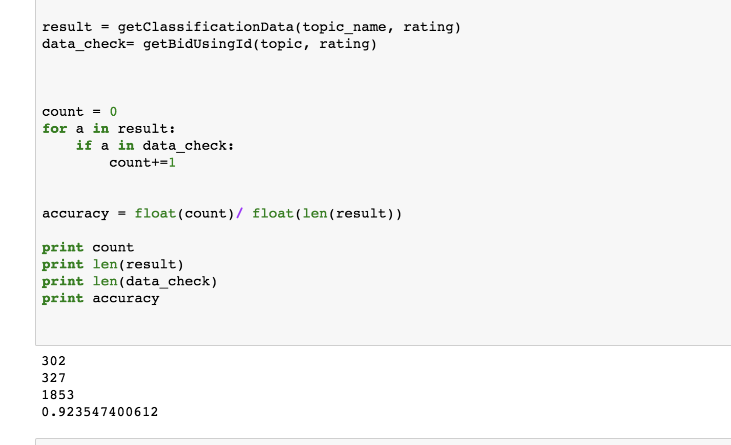
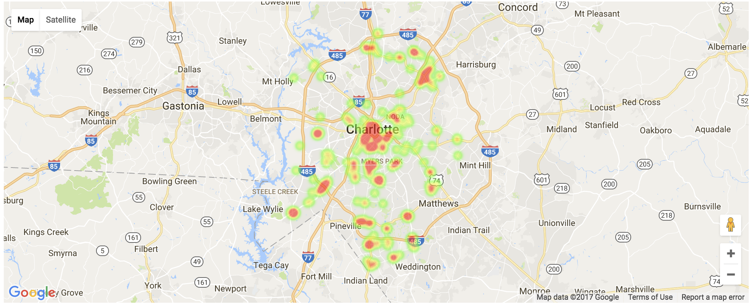
Task 2: Recommend location to user to open a specific cuisine of restaurant
Accuracy plotting for Sandwich cuisine:

Slide 21
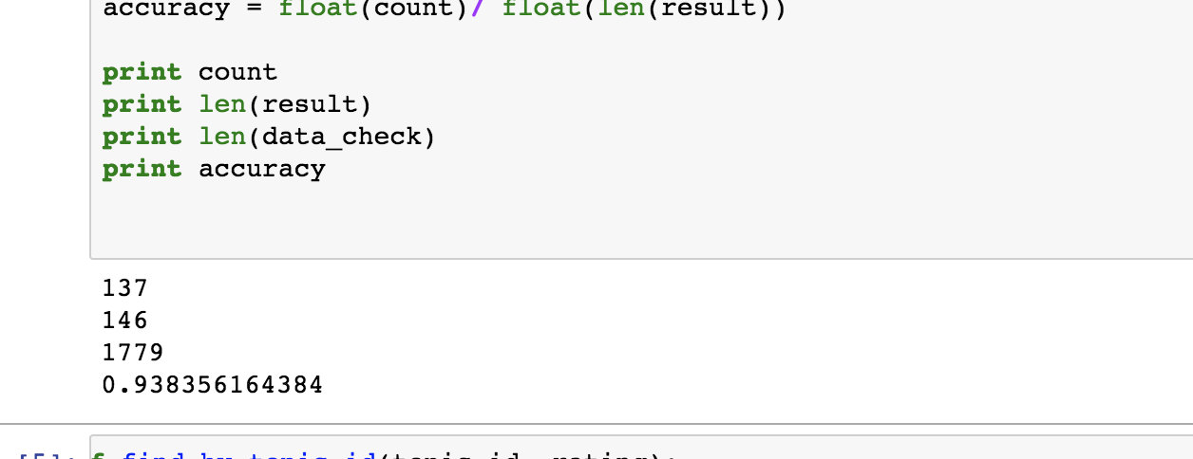
Task 2: Recommend location to user to open a specific cuisine of restaurant
Accuracy Plotting for cuisine Salad:

Slide 22
Task 2: Recommend location to user to open a specific cuisine of restaurant
Future Improvements:
Yelp can add another list of attributes in the Reviews collection where user can add the dis he is rating. This will help in richer prediction of places serving right food.
Our program depends on the occurrence of category in the review. We can elaborate this approach to deduce category of the food being referenced in the review using stemming or other logical analyzers. However, it is time consuming to implement in real time.
Our program only suggests the probable places with best rating of a sample cuisine. To setup a new business, user has to keep in mind the locality identified. Therefore, as an enhancement, we can incorporate the “monetary richness” of a locality too to suggest the right place to set up a business. This can be done if yelp incorporates cost of average meal of a particular business(here restaurant).

